Slide 1
Leviticus 23 - 25
Feasts, Festivals, The Holy Place
Sabbath Year and the Year of Jubilee

Slide 2
Leviticus – Be Holy for I am Holy
1-7 – Rituals – Sacrifices
      Thank You – Grain Offering & Fellowship Offering
      I’m Sorry – Burnt Offering, Sin Offering & Guilt Offering
8-10 – Priests – How they should serve
11-15 – Purity – Ritually Clean/Unclean or Pure/Impure
      Animals, birds, fish
      Human conditions (disease, birth, death)
16-17 – Day of Atonement – Annually for the Nation
18-20 – Purity – Morally Clean/Unclean or Pure/Impure
      Justice, Healthy Relationships, Sexual Integrity
21-22 – Priests – How they should live
23-27 – Rituals – Feasts & Sacred Days
      All part of telling the story of how God set Israel apart

Slide 3
Leviticus 23
  Sabbath
  Passover
  Feast of Unleavened Bread
  Feast of First Fruits
  Feast of Weeks
  Feast of Trumpets
  Day of Atonement
  Feast of Tabernacles
Leviticus 24
  Bread for the Tabernacle
  Punishment for Blasphemy
Leviticus 25
  Sabbath Year
  Year of Jubilee

Slide 4
Seven Annual Feasts & Festivals
Passover
  A meal on the 14th day of the 1st month (April 9-10, 2020)
Unleavened Bread
  Starts the 15th day of 1st month (April 10-18, 2020) on a Sabbath
  Ends one week later on a Sabbath
First Fruits
  First day of the week after Passover – 16th day of 1st month (April 11-12, 2020)
Pentecost/Weeks
  6th day of the 3rd month (May 29-30, 2020) – 50 days after Passover
Trumpets (Rosh Hoshanah)
  Jewish New Year – 1st day of 7th month (September 19-20, 2020)
Day of Atonement (Yom Kippur)
  10th day of 7th month (September 27-28, 2020)
Tabernacles/Booths/Tents
  15th day of 7th month (October 2-10, 2020)

Slide 5
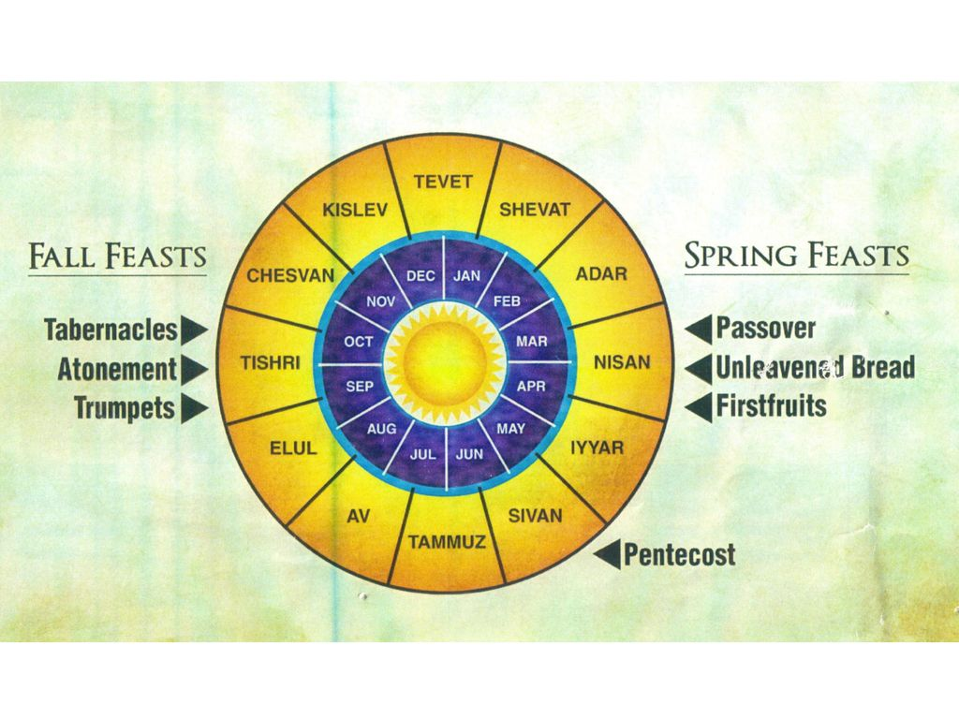

Slide 6
Passover, Unleavened Bread & First Fruits
Passover - Night before Sabbath
  Last night Israelites were in Egyptian slavery – a night of deliverance
  Mentioned 77 times in scripture (more than any other by over 7 times)
Unleavened Bread - Sabbath
  Remove all leaven from the house for 8 days (“Spring Cleaning”)
First Fruits – 1st Day of the week following Passover
  First (Spring) harvest (Spring barley)

Slide 7
Messianic Applications
Passover
  Jesus died for the sins of the world as the sinless, unblemished, perfect Lamb of God
Feast of Unleavened Bread
  Shows the true character of the sinless (unleavened) son of God who gave His body on the cross as a sacrifice for the sins of the world
Feast of First Fruits
  Jesus fulfilled this feast by being resurrected on the 1st day of the week

Slide 8
Pentecost (Weeks)
Pentecost is English spelling of a Greek word that means 50th
  It fell 50 days after Passover
    Like First Fruits, on the 1st day of the week
New grain offering baked with leaven
  Summer harvest (wheat)
  Only feast where leaven is permitted
  Two loaves on a single sheet
Next feast is not for about 100 days – why?
  What were Israelites supposed to do during that time?

Slide 9
Messianic Implications
Timing
  Coming of the Holy Spirit on apostles
  Birth of the church
Two wheat loaves with leaven on a single sheet
  Jewish & Gentile sinners saved in one body – Christ’s body – the church
  Wheat is symbol of evangelism in New Testament
  Jews ‘harvested’ first on Day of Pentecost in Acts 2
  Gentiles ‘harvested’ first in Acts 10

Slide 10
Feast of Trumpets
Rosh Hoshanah – Blowing of the shofar (ram’s horn)
  Jewish New Year going back to creation
    Just happened September 18-20 (It is the year 5781 right now)
  Therefore, a time of beginnings, starting over, repentance and dedication
  Tradition says God judges the world during the 10 days between the Festival of Trumpets and the Day of Atonement (Yom Kippur)
    Therefore, 10 days of penitence follow
Messianic Implications
  Fulfilled in the second coming of Christ
    Another beginning – eternity in heaven

Slide 11
Day of Atonement
Yom Kippur – The Holy of Holies
  Only one way to approach God
  Always by blood
Messianic Applications - Book of Hebrews
  Better High Priest – Hebrews 4:14-16; 5:1-7:28
  Better Covenant – Hebrews 8:1-13
  Better Tabernacle – Hebrews 9:1-10
  Better Sacrifice – Hebrews 9:11-10:18
  Better Altar – Hebrews 13:10-16

Slide 12
Feast of Tabernacles
Reason for Feast
  So that generations would remember they lived in tents when God delivered them from Egyptian slavery
  Sometimes called the Feast of Ingathering
Messianic Implications
  Remembering a time when they dwelt in temporary dwellings
  Looking forward to a permanent dwelling place being established
  Peter wrongfully applied this to the Mount of Transfiguration
  Properly fulfilled in the establishment of Christ’s kingdom

Slide 13
Summary
Passover was fulfilled on the day of the Feast by the death of Jesus
The Feast of Unleavened Bread was fulfilled by the sinlessness of His body being offered on the cross
The Feast of First-Fruits was fulfilled by the resurrection of Jesus
The Feast of Weeks was fulfilled by the birth of the Church the body of Christ
The Feasts of Trumpets will be fulfilled in the second coming of Christ
The Day of Atonement was fulfilled by Jesus blood being offered on the cross
The Feast of Tabernacles or Booths was fulfilled by the establishment of Christ’s kingdom

